Slide 1

LIKE

Slide 2
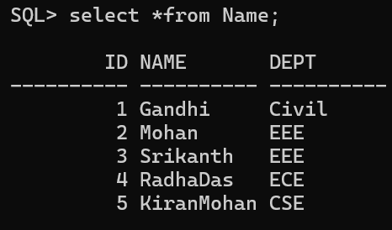



Slide 3
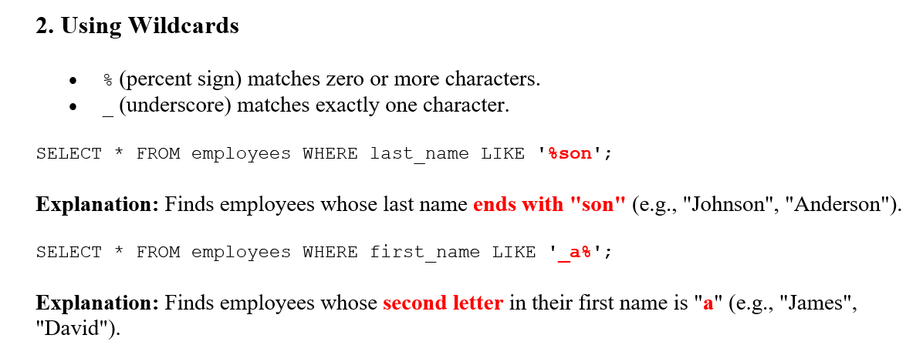

Slide 4


Slide 5


Slide 6
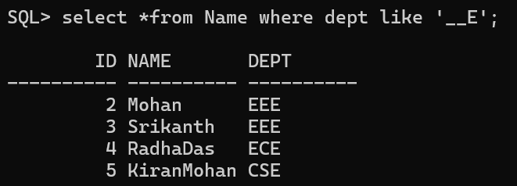

Slide 7
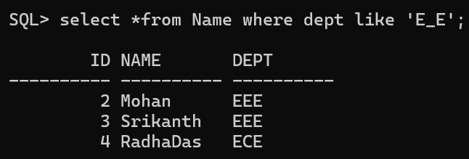

Slide 8


Slide 9
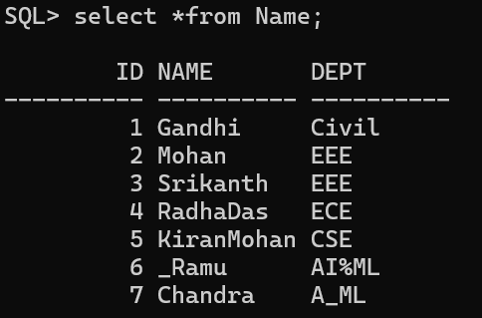



Slide 10


Slide 11



Slide 12


Slide 13
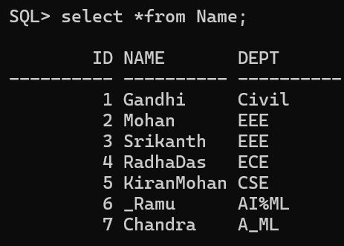

Contains a character at any place

Slide 14
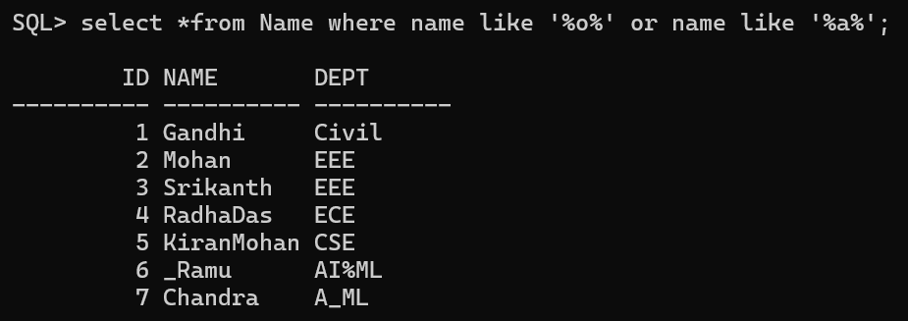

Slide 15


Slide 16


Starts and ends with same pattern

